Slide 1

CLINICAL CASE STUDY
Sendie Saint Fleur
Instructor: Lourdes Zambrana

Slide 2
Situation
Mrs Smith, a 42 year old female.
She is diagnosed with dyspnea.
Current respiratory orders include Ipatropium bromide (Atrovent®) and oxygen therapy.
Mrs. Smith is having increasing dyspnea and is complaining of chest pain.

Slide 3
The patient has a medical history of birth control pills and estrogen replacement therapy.
According to Kline, (2018), the patient has also had two cesarean section while giving birth due to her overweight.
Last ABG values for the patient are PaCO2 0.61 (0.44-0.85) 0.678 (0.64-0.72)
Abnormal ABG with acute dyspnea.

Slide 4
Background
Mrs Smith was admitted through Emergency Department with increasing dyspnea.
Her abdominal pain has gotten worse and now radiating to right lower quadrant.
The supporting background information is that she had a total knee replacement two days ago.
About two hours ago she began complaining of chest pain.

Slide 5
The patient’s pulse is 120 and her blood pressure is 128 over 54.
She is restless and short of breath.
The patient produces bloody or blood-streaked sputum at some instances.
Leg pain or swelling, or both. Kacmarek et al. (2019) argues that this is usually caused by a deep vein thrombosis.

Slide 6
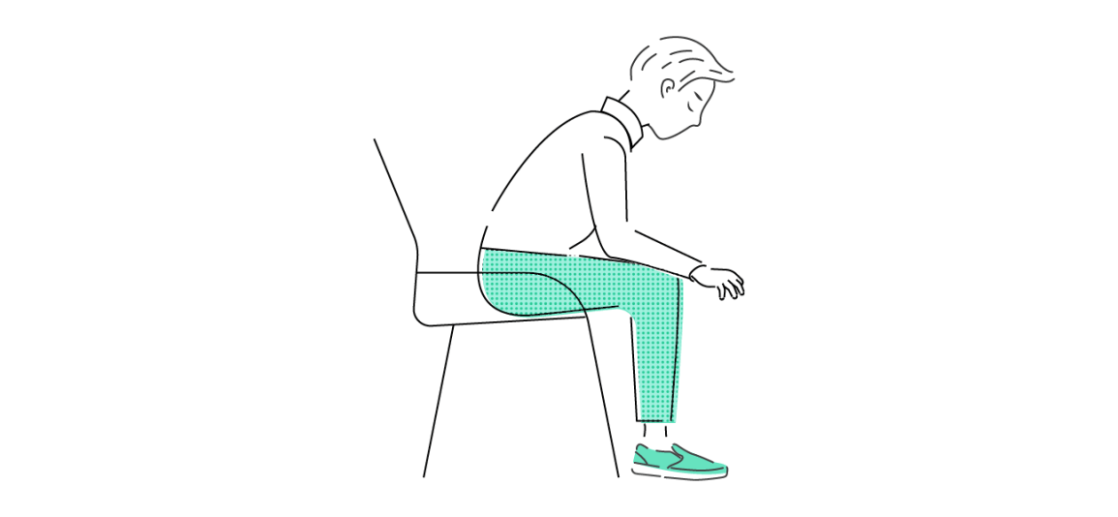
The patient holds a paroxysmal atrial fibrillation (AF), atrial flutter, atrial tachycardia, paroxysmal supraventricular tachycardia (PSVT) for some years.
This patient’s home treatment for dysnea involves Pursed-lip breathing, Diaphragmatic breathing and sitting forward.

Slide 7
Assessment
Mrs Smith looks unwell as his Sudden shortness of breath is increasing Chest pain is worsening.
Mr Smith has been throwing up more since he was admitted.
My assessment of the situation is that she may be having a cardiac event or a pulmonary embolism.

Slide 8
Test Results
Pulmonary angiography: Intra Lumina filling defect.
Ventilation: High clinical probability.
DVT: acute DVT evident with non-diagnostic ventilation –helica CT.
Negative D-dimer test with dimer sensitivity below 85%.

Slide 9
Echocardiogram, approximately 40 percent was found to have abnormalities of the right side of the heart, particularly the right ventricle.
The patient VQ scan showed breathes from a tube that contains a mixture of air, oxygen, and a slightly radioactive version of the gas xenon.
According to Kacmarek et al. (2019), this reveals air flow in different parts of the lung.
The other half of the images, the camera tracks the technetium reveals blood flow in different parts of the lung.
Some areas of the lung had significant “mismatches”—that is, good air flow but poor blood flow (Kline, 2018).

Slide 10
Critical Findings
Kline (2018) argues that Sudden shortness of breath leads to increased palpation.
Low PaO2and respiratory alkalosis- Due to increased total minute ventilation.
chest pain that may extend into your arm, jaw, neck, and shoulder
CT scan - Ground glass opacities scattered throughout - indicates pulmonary embolism (Kline, 2018).

Slide 11
Recommendation
I recommend that the patient should immediately use incentive Spirometer to help reduce breathing problems.
She should be given Systemic corticosteroid: Prednisolone, oral, 30-40 mg, daily for 10-14 days.
Provision of Home oxygen therapy to the patient with saturation of above 90%.
Kacmarek et al. (2019) argues that Anticoagulant medications, such as heparin, enoxaparin, or warfarin are crucial to help thin the blood and prevent further clotting.

Slide 12
The patient should be prescribed clot dissolvers (thrombolytics): These drugs speed up the breakdown of a clot (Kacmarek et al., 2019).
Surgical procedures may be done like vein filter to prevent blood clots from traveling from legs to your lungs.
The patient should be evaluated for home O2 requirement.
The patient may also need regularly exercising as legs are key components of therapy after a pulmonary embolism.

Slide 13
Reference
Kacmarek et al. (2019). Egan's Fundamentals of Respiratory Care E-Book. Elsevier Health Sciences.
Kline, J. A. (2018). Diagnosis and exclusion of pulmonary embolism. Thrombosis research, 163, 207-220.

